Slide 1
Person Re-identification Research Based on Deep Learning
presenter：tianyu97
2020年7月18日

Slide 2
目录 | CONTENTS
1
Introduction
2
Related works
3
Global and Local based ReID
4
Experiment Results and Analysis
5
Conclusion and Outlook

Slide 3
1
Introduction

Slide 4
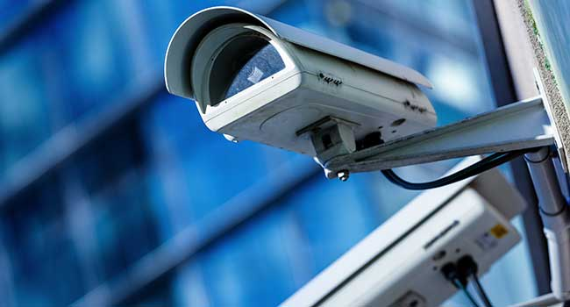
Background and Significance
1.1
The video surveillance system is more and more popular
30 Millions in China
Elevator
Hospital
Market
Station
School
When theft and robbery cases happen
When someone is missing and the police want to find him

Slide 5
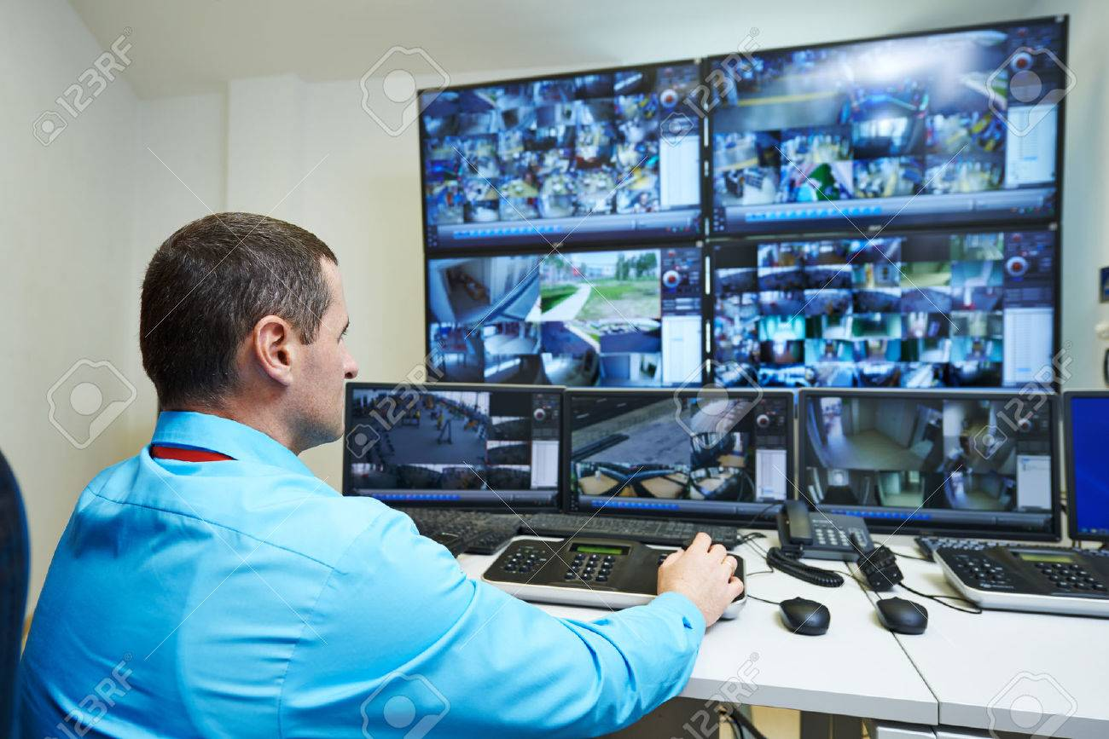
Background and Significance
1.1
Traditional method: manually However, this method is not only expensive and time-consuming but also has low accuracy. Because the video viewer will have visual fatigue due to watching the video for a long time.
How to find the target in a huge number of surveillance videos?
Traditional method: Manually
Disadvantages:
Expensive
Time-consuming
Low accuracy
Visual fatigue

Slide 6
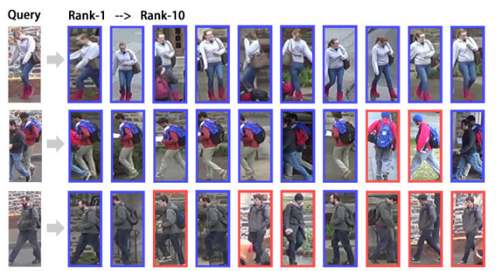
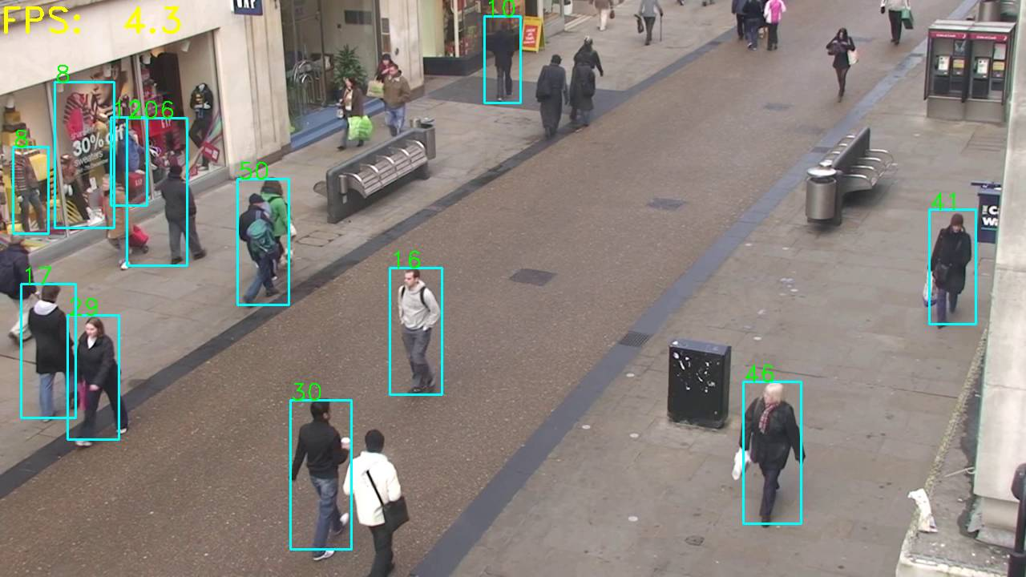
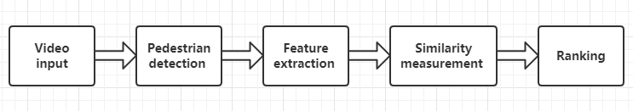
Concept
1.2
Person re-identification (Abbreviation: ReID) is a technology which identifies the same person in multiple different non-overlapping surveillance cameras.
Figure 1-1 complete person re-identification monitoring system

Slide 7
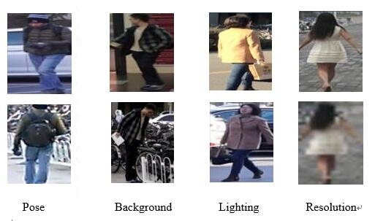
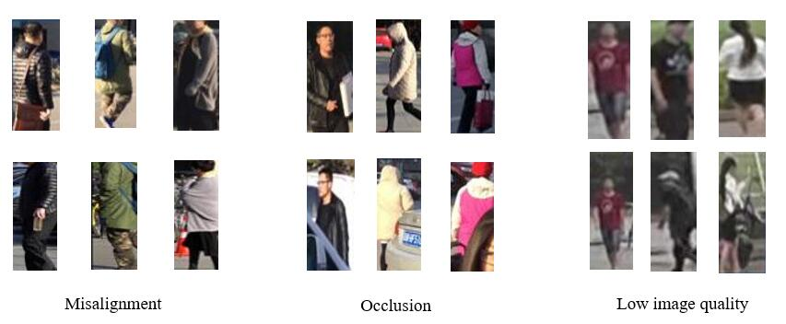
Problems and Difficulties
1.3
The huge variations of the pedestrian’s appearance
The non-ideal scene
The lack for large amounts of training data.
ImageNet dataset for image recognition: 1250k images
Caltech dataset for pedestrian detection: 350k images
CelebA dataset for face recognition: 200k images
The largest dataset for person re-identification: only have 30k images

Slide 8
2
Related works

Slide 9
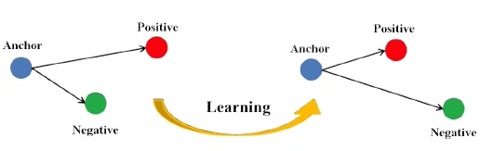
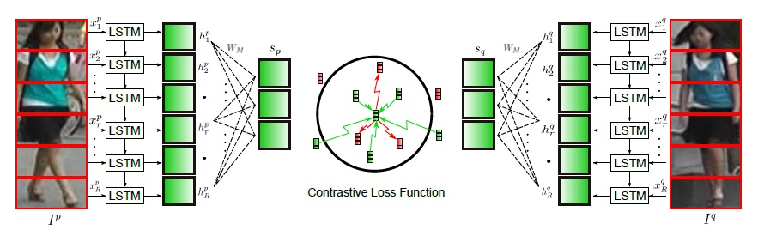
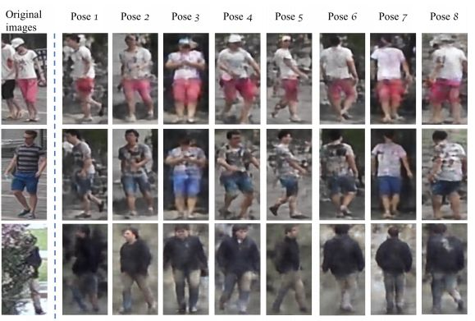
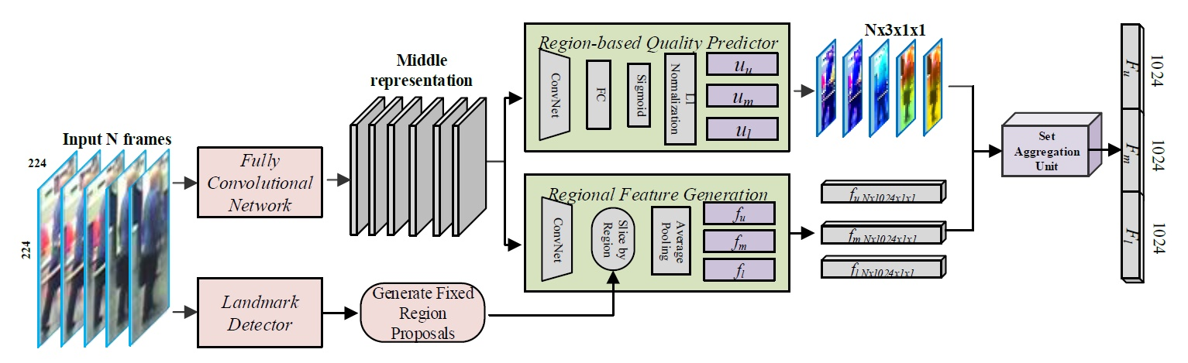
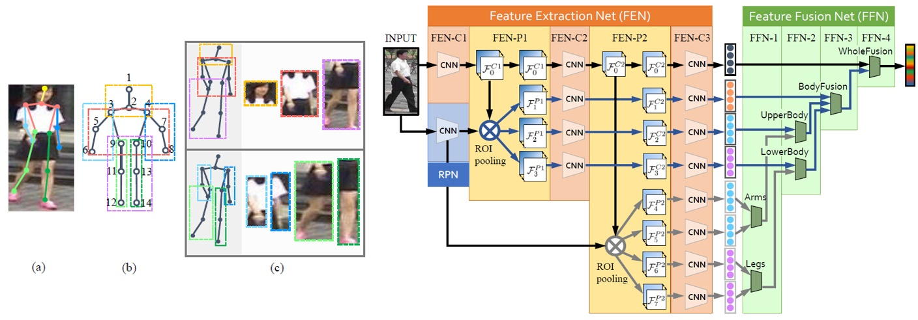
Related Works
2
Based on metric learning: Triplet loss, Quadruplet loss, TriHard loss, Margin sample mining loss
Based on feature extraction
Based on video sequence
Based on GAN mapping
Notes:
基于视频序列的方法最主要的不同点就是这类方法不仅考虑了图像的内容信息，还考虑了帧与帧之间的运动信息等。

Slide 10
3
Global and Local based ReID

Slide 11
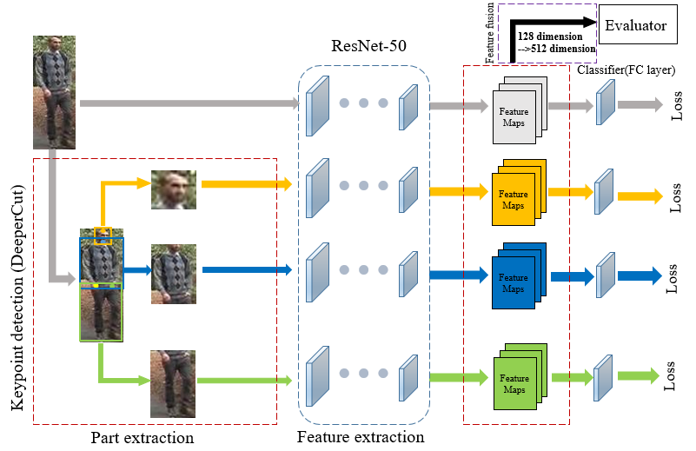
Model framework
3.1
Figure 3-1 The framework of the this work’s model

Slide 12
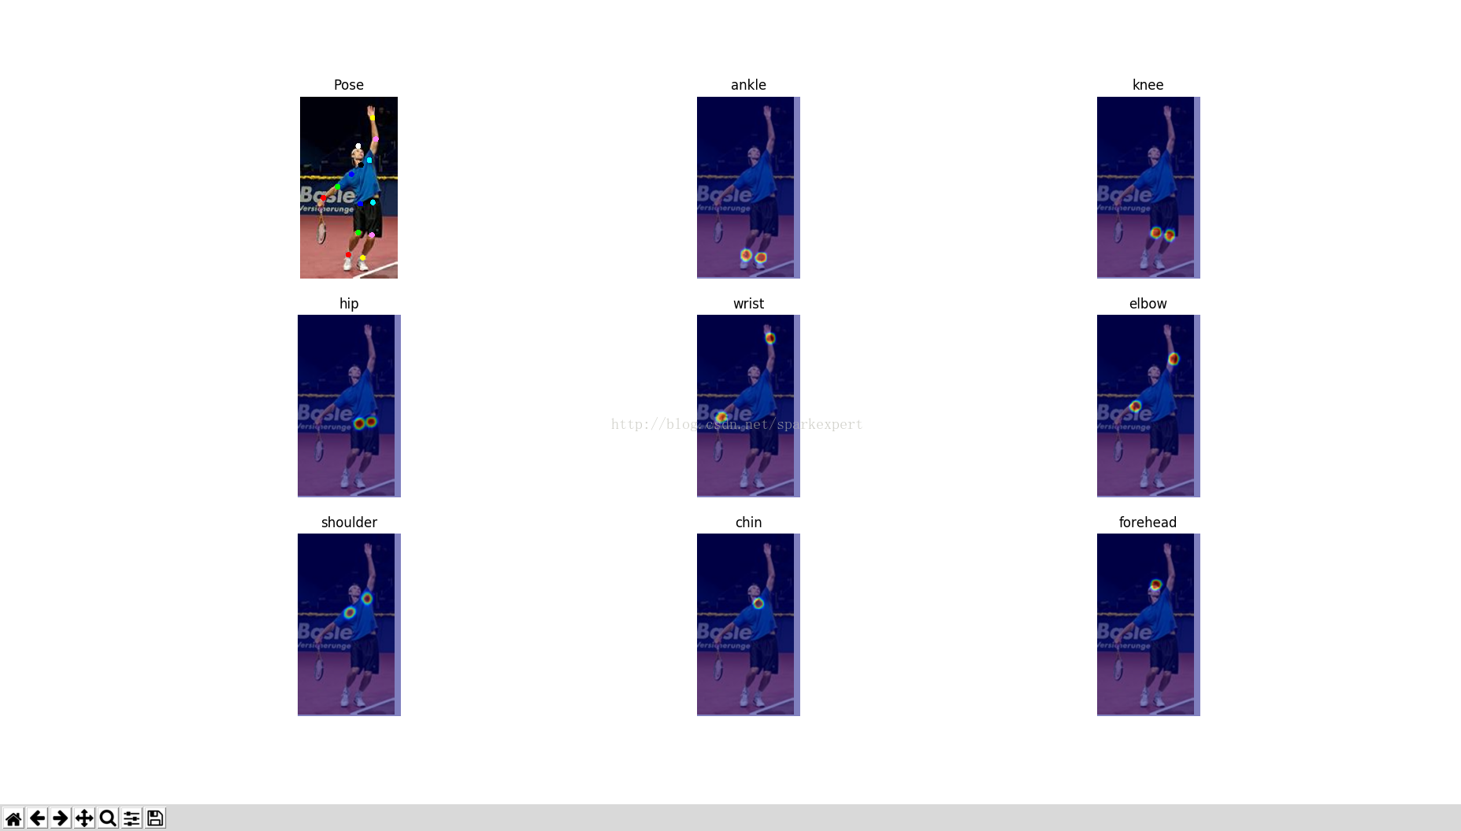
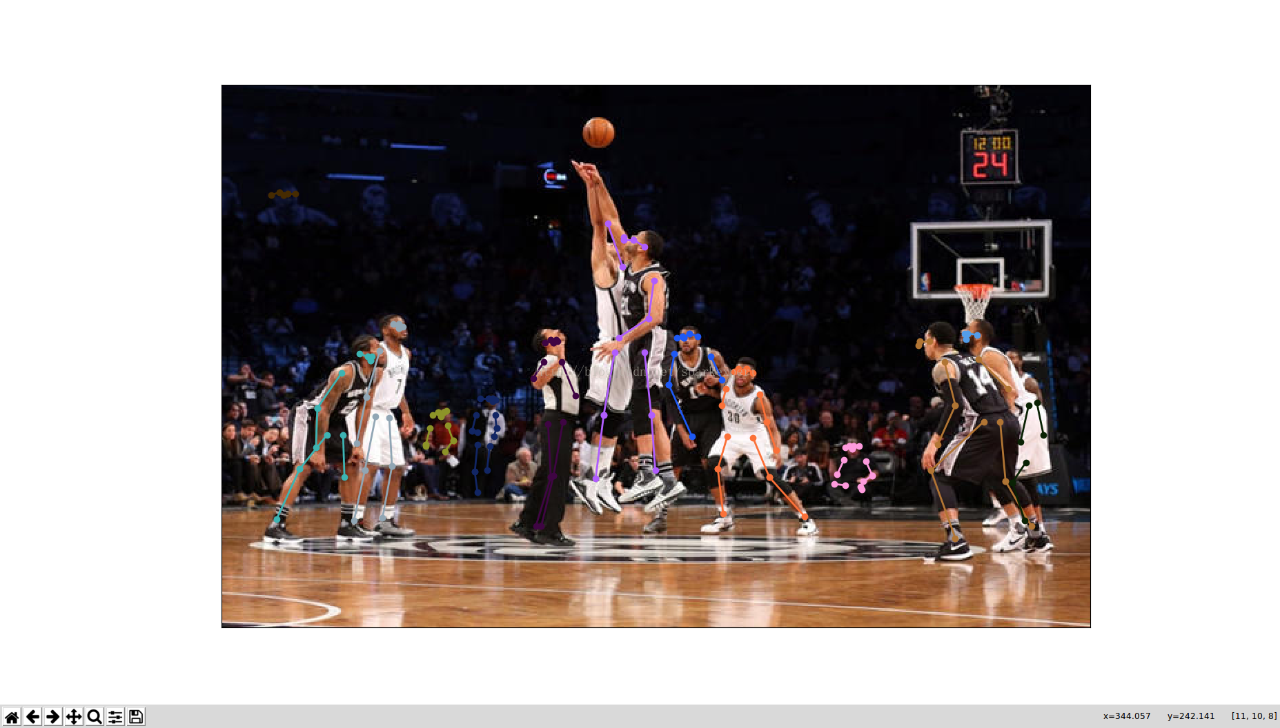
Part extraction —DeerperCut Algorithm: Key Points Detection
3.2
Figure 3-2 The example of the DeeperCut keypoint detection. Left is the single person, right is the muti-person.

Slide 13
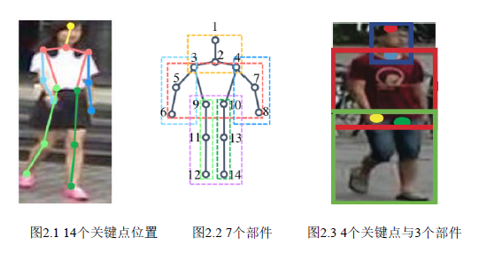
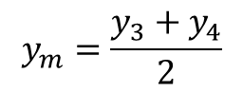
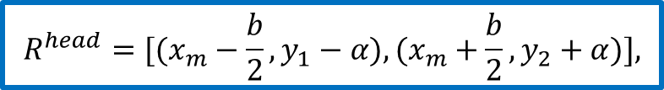
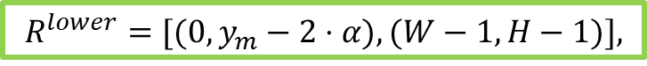
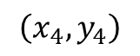
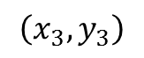
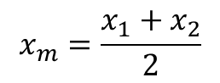
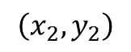
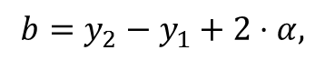
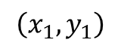
Part extraction —Part Division
3.3
Forehead:
$$\left(x_{1},y_{1}\right)$$
Chin:
$$\left(x_{2},y_{2}\right)$$
Left hip:
$$\left(x_{3},y_{3}\right)$$
Right hip:
$$\left(x_{4},y_{4}\right)$$
$$R^{head}=[(x_{m}−\frac{b}{2},y_{1}−α),(x_{m}+\frac{b}{2},y_{2}+α)],$$
$$b=y_{2}−y_{1}+2⋅α,$$
$$x_{m}=\frac{x_{1}+x_{2}}{2}$$
$$R^{upper}=[(0,y_{2}−2⋅α),(W−1,y_{m}+2⋅α)],$$
$$R^{lower}=[(0,y_{m}−2⋅α),(W−1,H−1)],$$
$$y_{m}=\frac{y_{3}+y_{4}}{2}$$

Slide 14
Model framework
Figure 3-1 The framework of the this work’s model

Slide 15
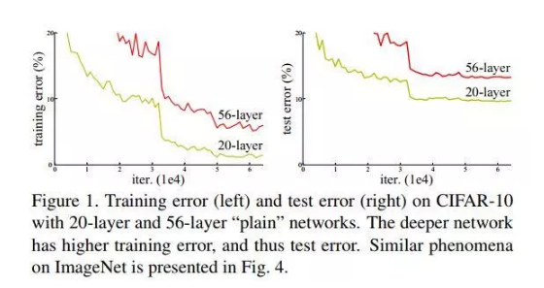
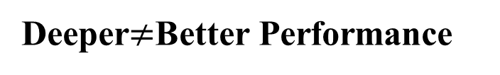
Feature Extraction — CNN Network
3.4
ImageNet Large Scale Visual Recognition Challenge (ILSVRC) is known as the "Olympic" in the field of international computer vision.
AlexNet(8 layers)
VGGNet(16-19layers)
GoogLeNet(22 layers)
Deeper$≠$Better Performance
Degradation
Figure 3-3 Training error(left) and test error(right) on CIFAR-10 with 20-layer and 56-layer “plain” networks. The deeper network has higher training error

Slide 16
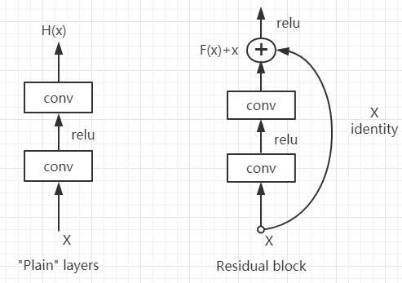
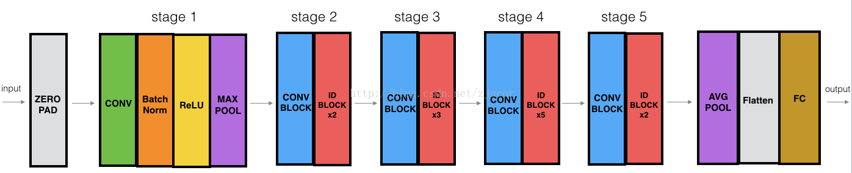
Feature Extraction — CNN Network
3.4
Figure 3-4 Ordinary Network and ResNet Residual Learning Unit
Figure 3-5 The basic framework of ResNet-50

Slide 17
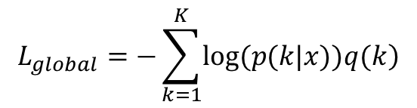
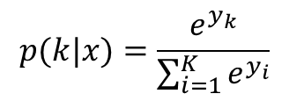
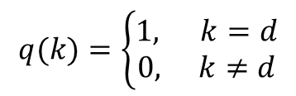
Feature Extraction — Loss Function
3.5
Softmax loss
$$p(k|x)=\frac{e^{y_{k}}}{\sum_{i=1}^{K}{e^{y_{i}}}}$$
$$L_{global}=−\sum_{k=1}^{K}{\left.log(p(k|x))q(k\right)}$$
$$q(k)=\left\{\begin{matrix}1, k=d \\ 0, k≠d\end{matrix}\right.$$

Slide 18
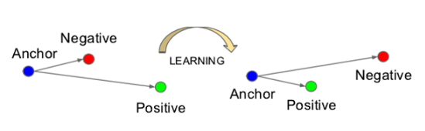
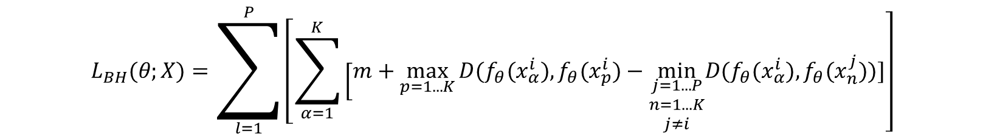
Feature Extraction — Loss Function
3.5
Triptlet Loss
Figure 3.7 The visualization of learning objectives of Triplet Loss
$$\left.L_{BH}(θ;X)=\sum_{l=1}^{P}{\left[\sum_{α=1}^{K}{\left[m+\max_{p=1...K}\right.}\right.}D(f_{θ}(x_{α}^{i}),f_{θ}(x_{p}^{i})−\min_{\begin{matrix}j=1...P \\ n=1...K \\ j≠i\end{matrix}}D(f_{θ}(x_{α}^{i}),f_{θ}(x_{n}^{j}))]\right]$$

Slide 19
Model framework
Figure 3-1 The framework of the this work’s model

Slide 20
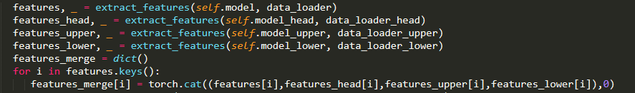
Feature Matching
3.6
Feature Fusion
Figure 3-8 The code example of feature fusion
128 dimension features
512 dimension features

Slide 21
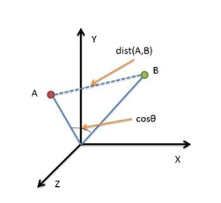
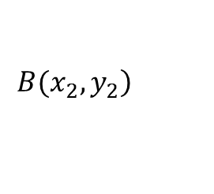
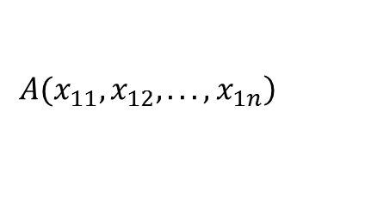
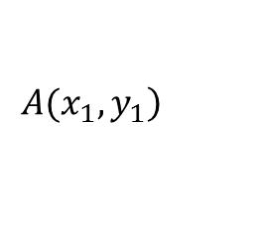
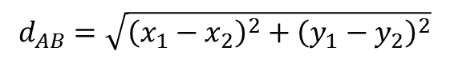
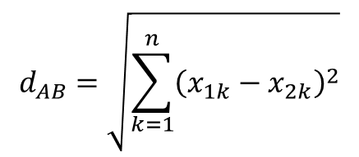
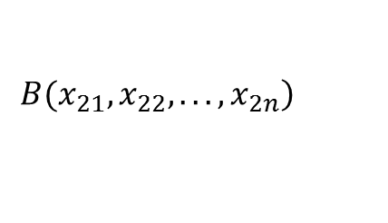
Feature Matching
3.6
Euclidean Distance
2-dimensional
$$\left.A(x_{1},y_{1}\right)$$
$$\left.B(x_{2},y_{2}\right)$$
$$d_{AB}=\sqrt{{\left(x_{1}−x_{2}\right)}^{2}+{\left(y_{1}−y_{2}\right)}^{2}}$$
N-dimensional
$$\left.A(x_{11},x_{12},...,x_{1n}\right)$$
$$\left.B(x_{21},x_{22},...,x_{2n}\right)$$
$$d_{AB}=\sqrt{\sum_{k=1}^{n}{{\left(x_{1k}−x_{2k}\right)}^{2}}}$$

Slide 22
4
Experiment Results and Analysis

Slide 23
Datasets
4.1
Market-1501 dataset
CUHK03 Dataset
It contains 1501 pedestrians and 32668 pedestrian rectangular frames captured by six cameras
It contains 1467 different pedestrians and is collected by 5 pairs of cameras. Each individual image is captured from two different cameras.

Slide 24
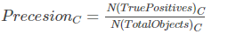
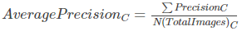
Evaluation method
4.2
CMC curve
The accumulative matching characteristic (CMC) curve
$$Acc_{k}\left\{\begin{matrix}1 if top−k ranked gallery samples contain the query identity \\ 0 otherwise \end{matrix}\right.$$
mAP
Mean average precision
Notes:
Because in this work, ReID is muti-shot, that is to say, there is more than one matching pedestrian images in the gallery set. It is biased to use only a few topk as the measurement criteria.

Slide 25
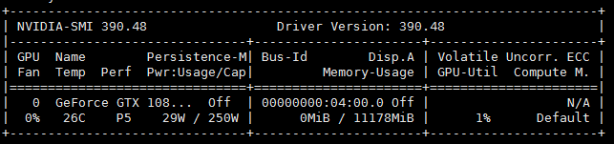
Environment
4.3
Environment | Edition
GPU | GTX 1080 Ti
Ubuntu | 16.04.4 LTS
CUDA | 9.1.85
CUDNN | 7.1.3
Python | 3.6.2
PyTorch | 1.0.1.post2

Slide 26
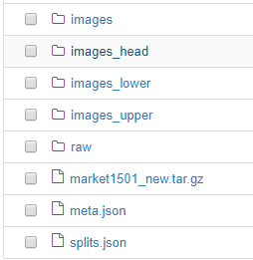

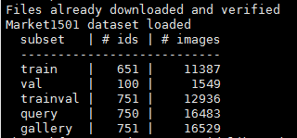
Training Process —Preprocessing the data
4.3

Slide 27
Training Process
4.4
Forward propagation
Back propagation
Label
Training Set
CNN Network
Loss Function
Update the parameters
Optimizer

Slide 28
4.4
Training Process
Hyper-parameters | Value
Optimizer | SGD
Learning rate | 0.1-0.01-0.001
Batch size | 128
epoch | 50
Weight decay | 5e-4
Training time: 5 hours around

Slide 29
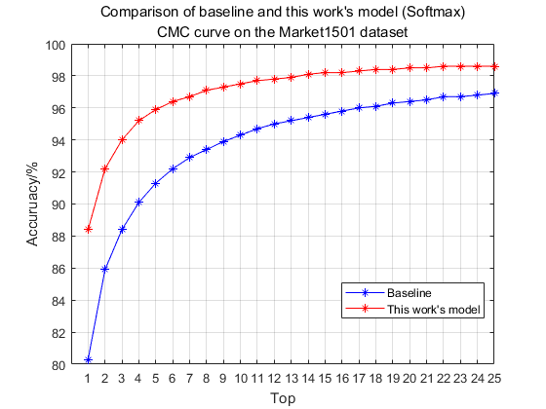
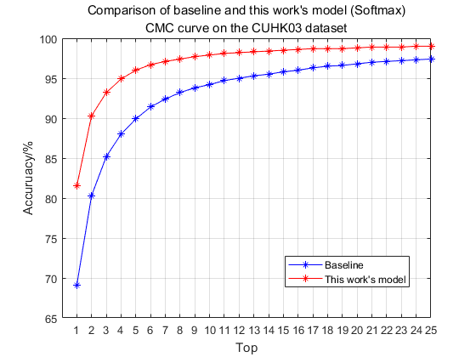
Results —Comparison with baseline
4.5
Market1501
CUHK03
Model | mAP/%
Baseline | 59.3
This model | 69.9
Model | mAP/%
Baseline | 63.2
This model | 76.0

Slide 30
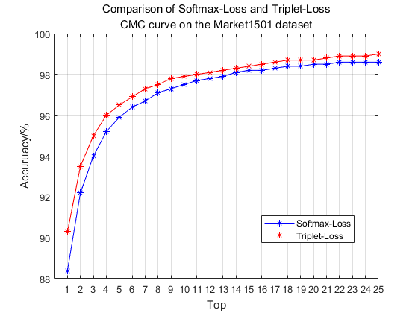

Results —Comparison of different loss function
4.6
Market1501
CUHK03
Loss function | mAP/%
Softmax Loss | 69.9
Triplet Loss | 76.8
Loss function | mAP/%
Softmax Loss | 76.0
Triplet Loss | 82.9

Slide 31
Results —Comparison with the existing methods
4.6
Market1501
CUHK03
Methods | Rank-1 | Rank-5 | Rank-10 | mAP
HydraPlus(ICCV2017)^{[38]} | 76.9 | 91.3 | 94.5 | -
PAR(ICCV2017)^{[39]} | 81.0 | 92.0 | 94.7 | 63.4
SVDNet(ICCV2017)^{[40]} | 82.3 | 92.3 | 95.2 | 62.1
PDC(ICCV2017)^{[41]} | 84.4 | 92.7 | 94.9 | 63.4
GLAD(ACM MM2017)^{[37]} | 89.9 | - | - | 73.9
AACN(CVPR2018)^{[42]} | 85.9 | - | - | 66.9
MLFN(CVPR2018)^{[43]} | 90.0 | - | - | 74.3
Baseline | 80.3 | 91.3 | 94.3 | 59.3
This work’s model | 90.3 | 96.5 | 97.9 | 76.8
Methods | Rank-1 | Rank-5 | Rank-10 | mAP
In^{[44]} | 75.5 | 95.2 | 99.2 | -
Deep^{[45]} | 84.1 | - | - | -
Unlabeled(ICCV2017)^{[46]} | 84.6 | 97.6 | 98.9 | -
A^{[47]} | 83.4 | 97.1 | 98.7 | -
DGD(CVPR2016)^{[48]} | 72.6 | 91.6 | 95.2 | -
Baseline | 69.1 | 89.9 | 86.2 | 63.2
This work’s model | 85.9 | 97.8 | 98.9 | 82.9

Slide 32
5
Conclusion and Outlook

Slide 33
Conclusion
5.1
Design an end-to-end Person ReID Network structure based on ResNet-50
Propose a ReID method based on pedestrian parts
Compare the two loss functions for the proposed model
The performance of this model has reached the state-of-art results.

Slide 34
Outlook
5.2
Combine the attributes with the features of the parts
Combine face recognition
Extend the model to solve video-based ReID problem
Merge the pedestrian detection and recognition to form an integrated framework

Slide 35
Thanks
presenter：tianyu97

